Slide 1

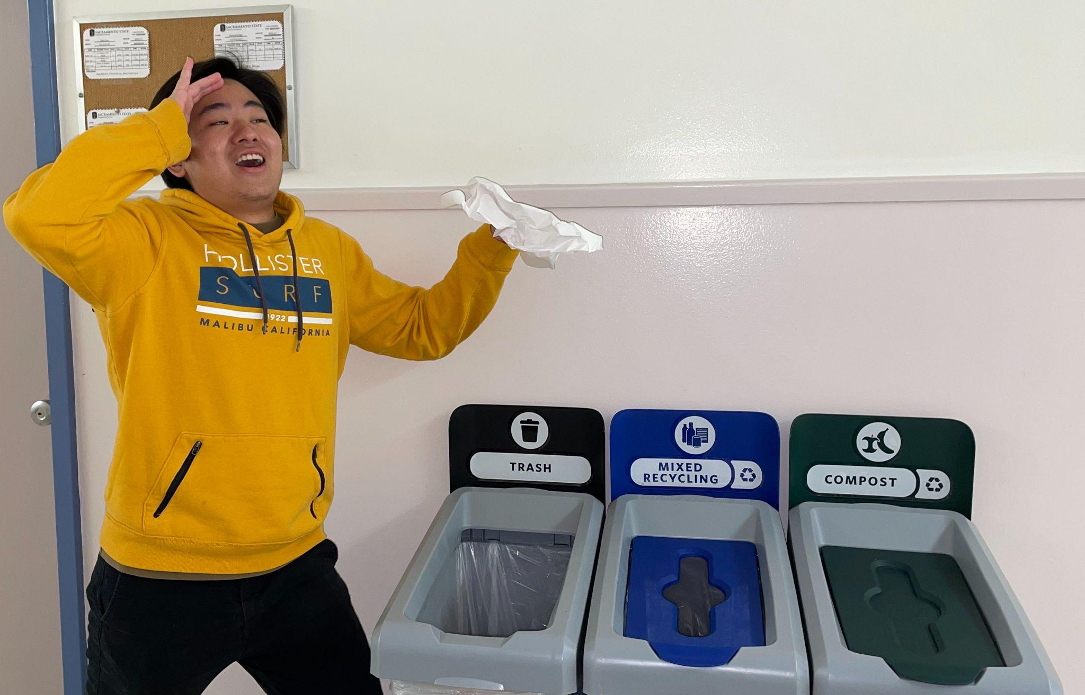


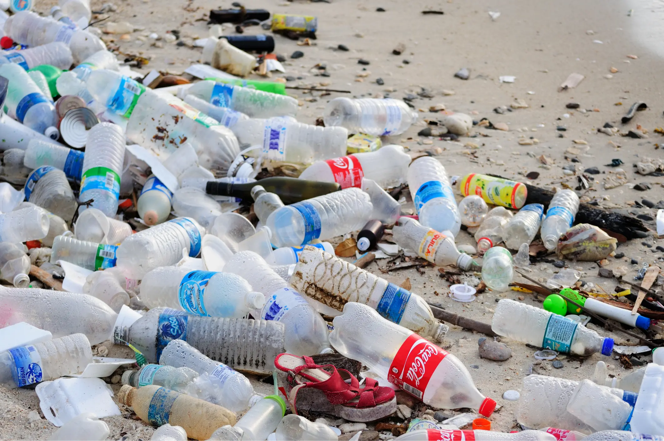
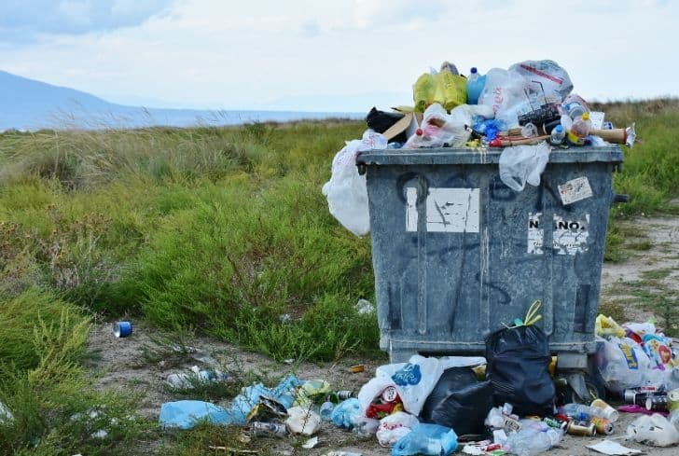
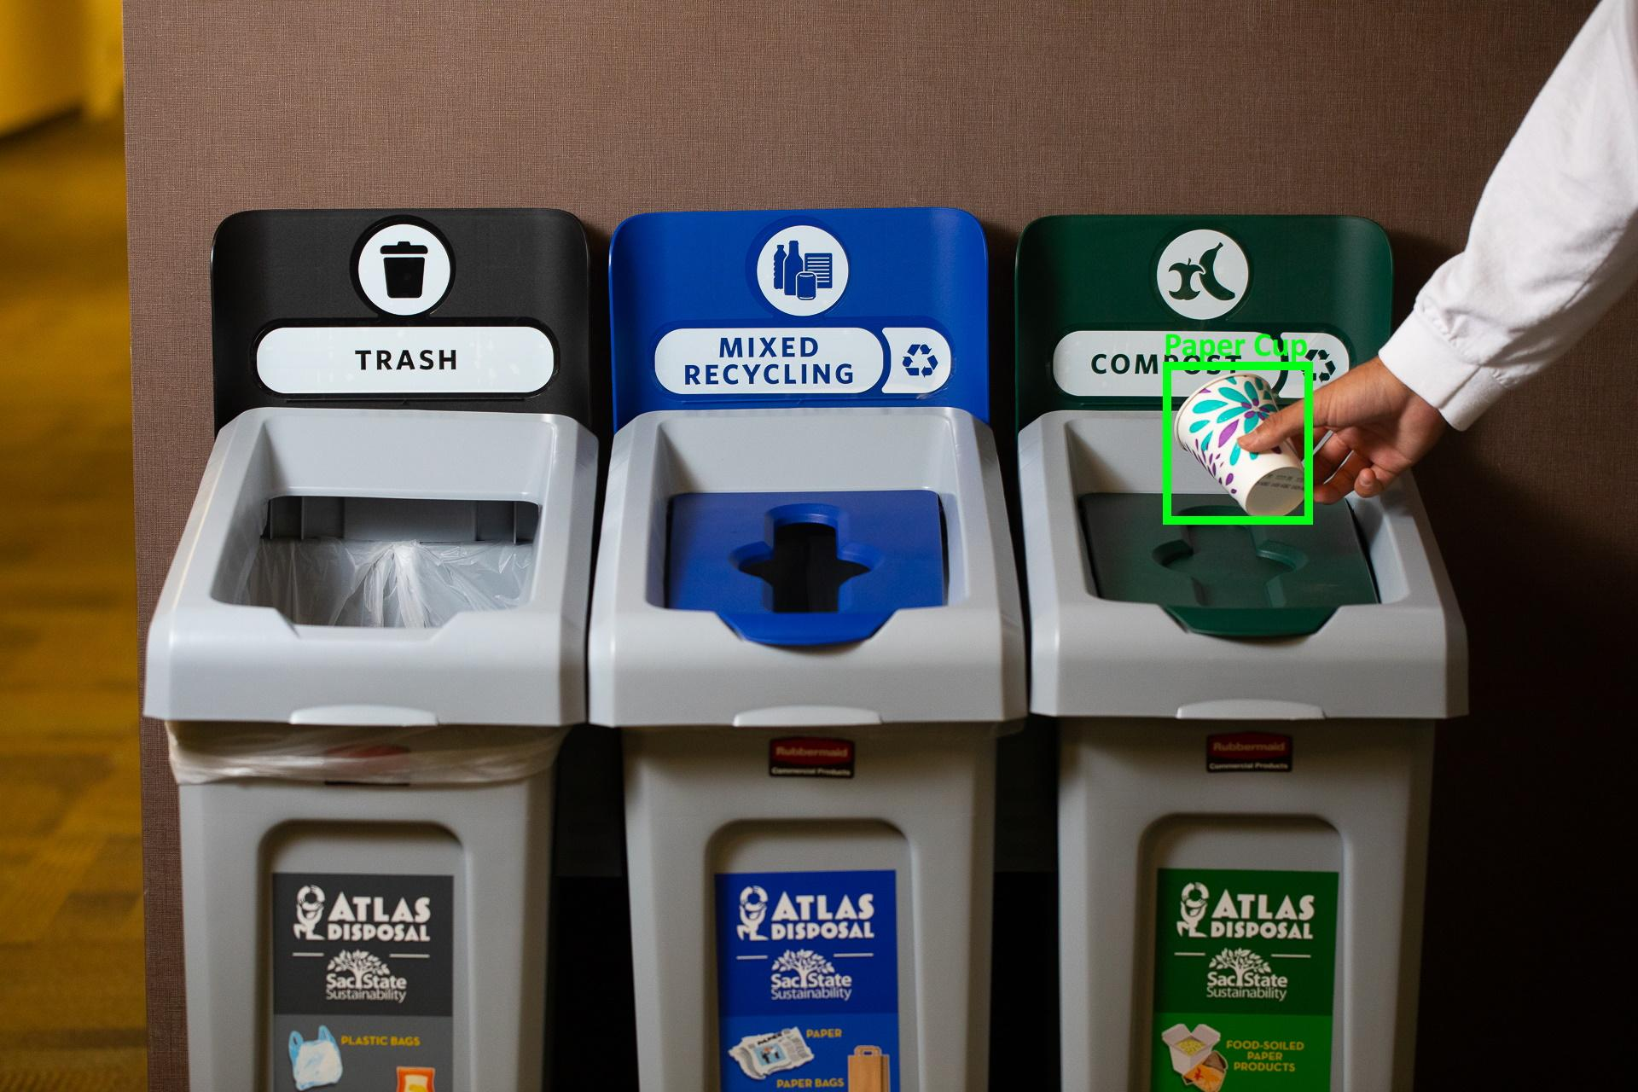
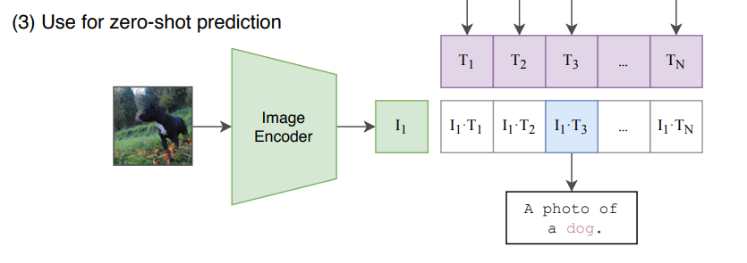
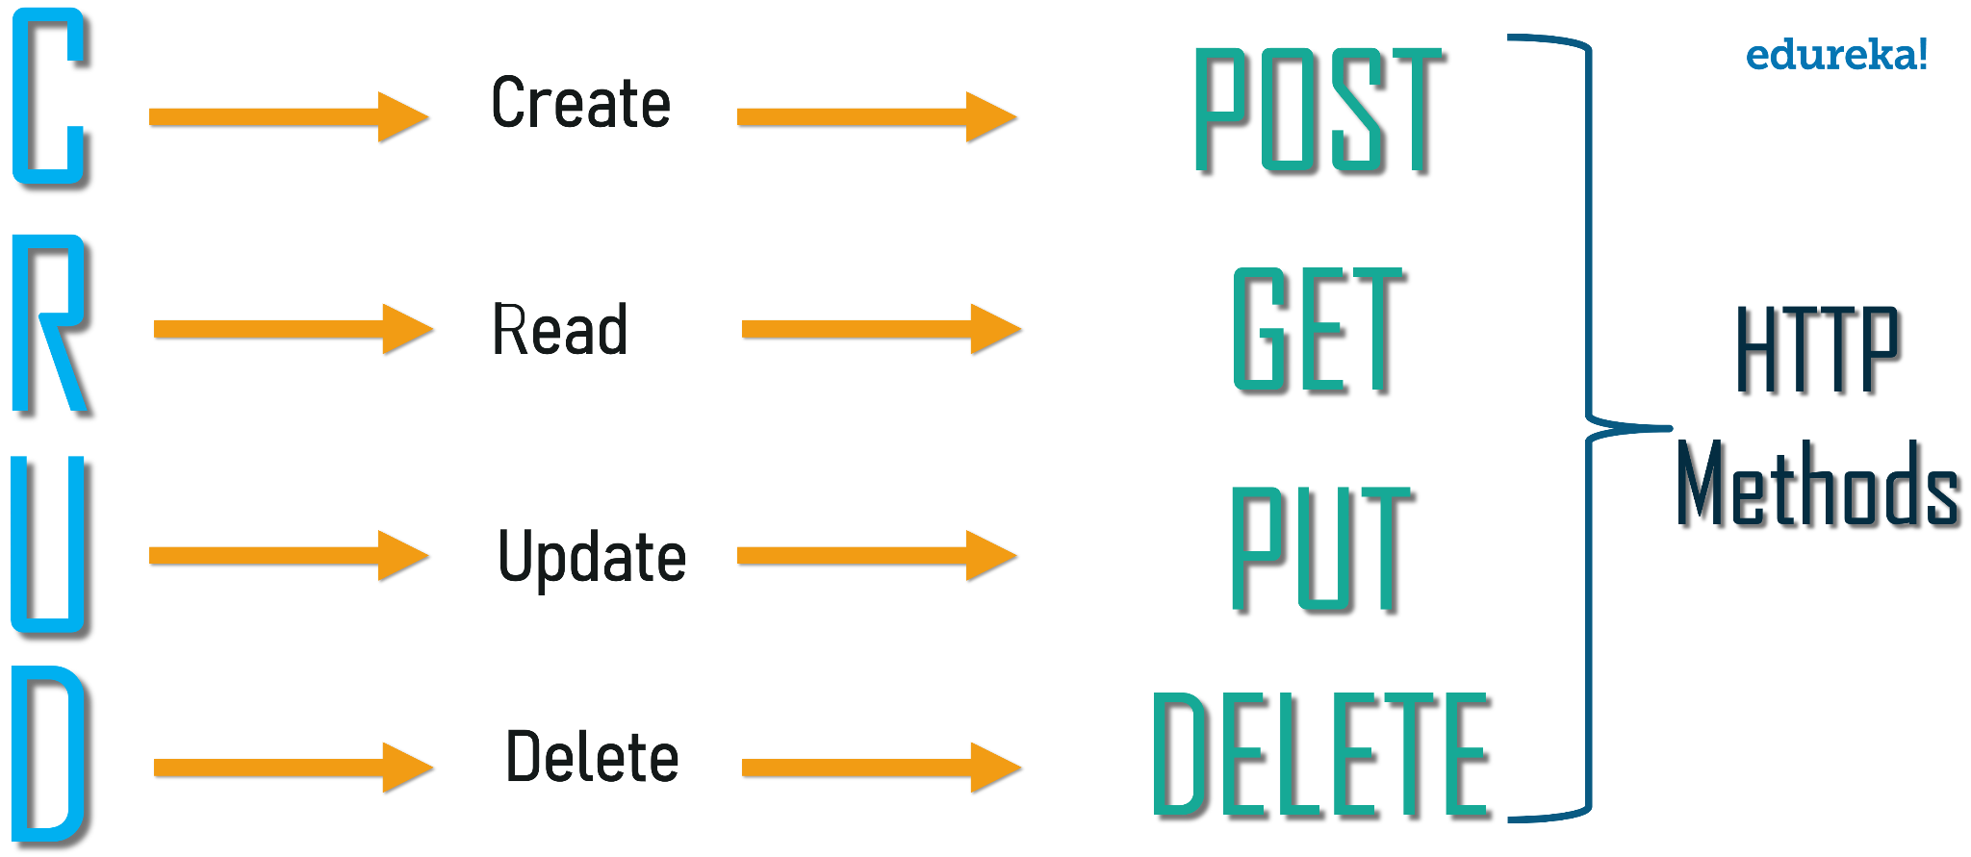

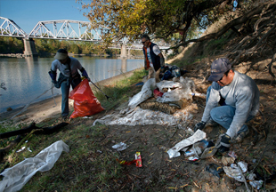

Automatically Classifying Waste to Different Trash Bins with Machine Learning
Bryan Burch, Christopher Allen, Daniel Smagly, Jeffrey de Jesus, Julian Hernandez, Kenta Miyahara, Santiago Bermudez, Travis Hammond, Kenneth Elliott, Ph.D
PROBLEM STATEMENT
Over the past decade, global municipal solid waste (MSW) has nearly doubled, and continues to increase. In 2002 we produced 0.68 billion tonnes of MSW, which is expected to increase to 2.2 billion by 2025, tripling in approximately 20 years. Post-consumer waste also accounts for 1,460 mtCO2e of our collective greenhouse gas (GHG) emissions. The most important way to reduce consumer greenhouse gas emissions is to educate consumers on the best reduction and sorting practices. To help Californians separate recyclables properly and now organic materials, we will use a neural network based program to give proper disposal advice. We expect the precision of our program to be better than current Californian sorting rates [CalEPA]. We can also deploy this technology in trash cans to provide suggestions to the user, or to measure waterway plastic reduction efforts. Our goal is to use neural networks to develop a trash sorting program that is more accurate than humans and that can help reduce improper disposal at the local level.
BACKGROUND
SUMMARY OF WORK
COMMUNITY IMPACT
Previous Research
Explored using Mask RCNN for object segmentation of trash in the wild to count how much trash is in different locations from images
Technologies We are Using
Flask
Rest API
SQLite
React (web frontend)
PyTorch/OpenCLIP (Neural Networks)
Efficient Net: Convolution Layers
CLIP: Transformer Layers
Jupyter Notebooks
Python
Front-End App
Designed with simplicity and ease of use in mind, the user interface is a lightweight terminal application and simple website
Backend
Designed to be overly general to handle model needs and database needs following the REST API standards
Model
OpenCLIP models for both GPU and CPU object classification, and EfficentNetV2 for GPU classification
To collect our training data we are working with the American River Parkway Foundation and Intel to collect new images that will be annotated. This will ensure that as our increase the accuracy of our algorithm we are also benefiting the community. The American River Parkway is interested in using this software to report how much litter their “1 Mile” partners are cleaning each month.
Intel clean-up:
Brown’s Ravine 1 Mile Section
CSUS Symposium 2nd Place
Our project received the Provost’s Award for Research Excellence and will be presented at the CSU wide research symposium at San Diego State University
CSUS Student Sustainability Grant Recipient
We received funding to purchase clean up equipment and hardware for remote inference
Figure 1: Classification
Figure 2: Neural Network CLIP Zero-Shot Prediction
Figure 3: Rest API Concept
Notes:
Enable guides to view printable area. Half inch bleeds (vertical guidelines which denote extra print area for when the physical posters are made) are included on either side of the document. Make sure your content is not overlapping or extending past these guides, as any content outside this area will be cut when the physical poster is made.

